Slide 1
CLLLC gain curves
Lim Shu Fan
05.04.2022

Slide 2
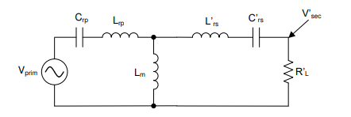
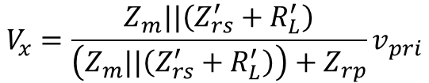
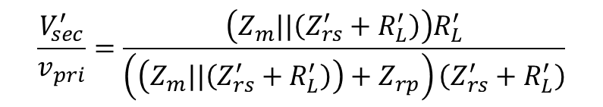
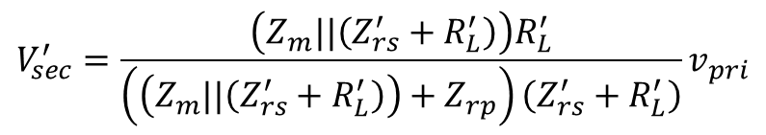
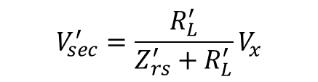
FHA CLLLC in Forward Power Flow
Vx
$$V_{x}=\frac{Z_{m}||\left(Z_{rs}^{′}+R_{L}^{′}\right)}{\left(Z_{m}||\left(Z_{rs}^{′}+R_{L}^{′}\right)\right)+Z_{rp}}v_{pri}$$
$$V_{sec}^{′}=\frac{R_{L}^{′}}{Z_{rs}^{′}+R_{L}^{′}}V_{x}$$
$$V_{sec}^{′}=\frac{\left(Z_{m}||\left(Z_{rs}^{′}+R_{L}^{′}\right)\right)R_{L}^{′}}{\left(\left(Z_{m}||\left(Z_{rs}^{′}+R_{L}^{′}\right)\right)+Z_{rp}\right)\left(Z_{rs}^{′}+R_{L}^{′}\right)}v_{pri}$$
$$\frac{V_{sec}^{′}}{v_{pri}}=\frac{\left(Z_{m}||\left(Z_{rs}^{′}+R_{L}^{′}\right)\right)R_{L}^{′}}{\left(\left(Z_{m}||\left(Z_{rs}^{′}+R_{L}^{′}\right)\right)+Z_{rp}\right)\left(Z_{rs}^{′}+R_{L}^{′}\right)}$$
Reference: TI Design guide TIDM-02002

Slide 3
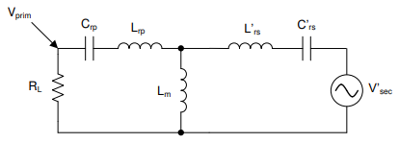
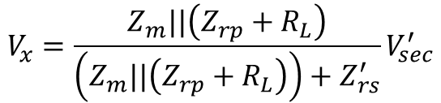
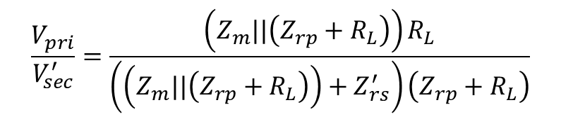
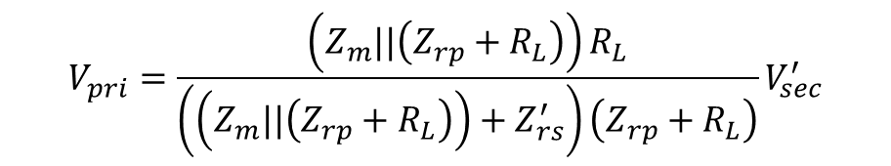
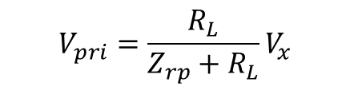
FHA CLLLC in Reverse Power Flow
Vx
$$V_{x}=\frac{Z_{m}||\left(Z_{rp}+R_{L}\right)}{\left(Z_{m}||\left(Z_{rp}+R_{L}\right)\right)+Z_{rs}^{′}}V_{sec}^{′}$$
$$V_{pri}=\frac{R_{L}}{Z_{rp}+R_{L}}V_{x}$$
$$V_{pri}=\frac{\left(Z_{m}||\left(Z_{rp}+R_{L}\right)\right)R_{L}}{\left(\left(Z_{m}||\left(Z_{rp}+R_{L}\right)\right)+Z_{rs}^{′}\right)\left(Z_{rp}+R_{L}\right)}V_{sec}^{′}$$
$$\frac{V_{pri}}{V_{sec}^{′}}=\frac{\left(Z_{m}||\left(Z_{rp}+R_{L}\right)\right)R_{L}}{\left(\left(Z_{m}||\left(Z_{rp}+R_{L}\right)\right)+Z_{rs}^{′}\right)\left(Z_{rp}+R_{L}\right)}$$
Reference: TI Design guide TIDM-02002

Slide 4
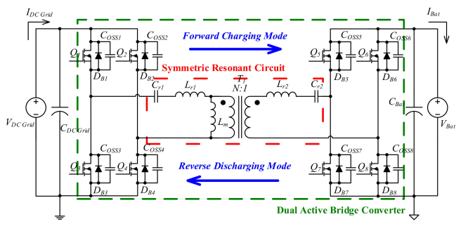








11kW tank design (Sin)
$$n_{CLLC}=1$$
$f_{r}=73$kHz
$$L_{r1}=36uH$$
$$L_{m}=160uH$$
$$L_{r2}=22uH$$
$$L_{n}=4.44$$
$C_{r1}=132$nF
$C_{r2}=216$nF
Reference: Design of an Isolated Bidirectional Symmetric Resonant Converter

Slide 5
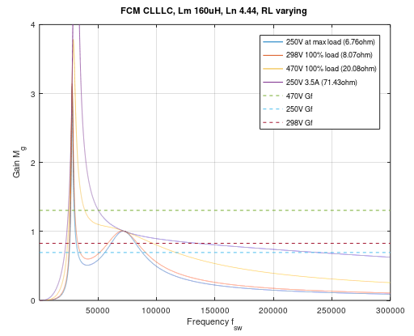
11kW tank design (Sin) Forward
Note blue should be 470V and green should be 250V
At Iout=3.5A under 470V, fsw will reach around 240kHz. The current reference for constant current control should not be lower than 3.5A when battery voltage is 470V to limit max frequency. Min frequency is around 39kHz at 250V full load.

Slide 6
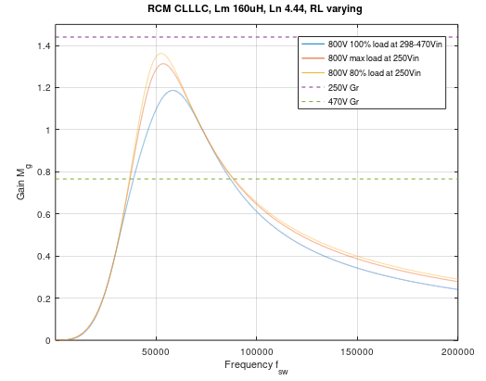
11kW tank design (Sin) Reverse
Under reverse power flow, the gain line at 250V is not crossing any of the load curves. This kind of concerns me but it works in simulation to settle at a steady state operating point. From simulation, it is 60-100kHz.

Slide 7
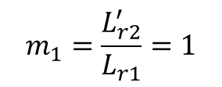








22kW Tank design from HQ
$$n_{CLLC}=1$$
$f_{r}=$100kHz
$$L_{r1}=22.45uH$$
$$L_{m}=67.36uH$$
$$L_{r2}=22.45uH$$
$L_{n}=$3
$g_{1}=\frac{C_{r2}^{′}}{C_{r1}}$=1
$C_{r1}=112.93$nF
$C_{r2}=112.93$nF
$$m_{1}=\frac{L_{r2}^{′}}{L_{r1}}=1$$
Reference: Design of an Isolated Bidirectional Symmetric Resonant Converter

Slide 8
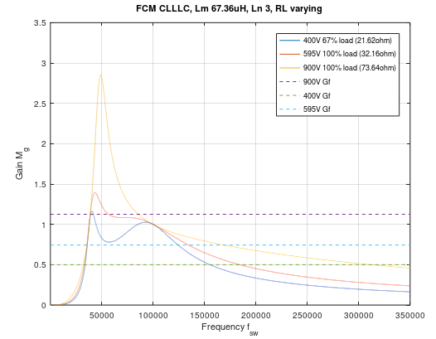
22kW tank design (HQ) Forward
At Iout=5.43A under 400V, fsw will reach around 312kHz. The current reference for constant current control should not be lower than 5.43A when battery voltage is 400V to limit max frequency. Min frequency is around 80kHz at 900V full load.

Slide 9
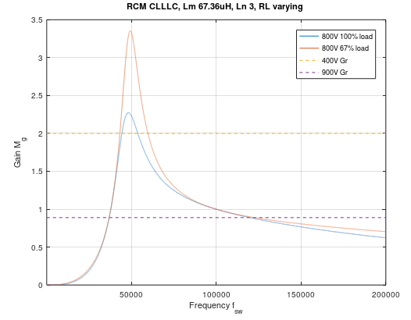
22kW tank design (HQ) Reverse
Under reverse power flow, should be able to regulate for full load range under a limited frequency range between 53kHz to 150kHz.

Slide 10
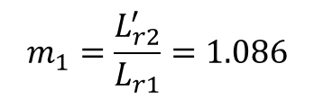








22kW Optimized Tank design from Sin
$$n_{CLLC}=1.33$$
$f_{r}=$100kHz
$$L_{r1}=33.8uH$$
$$L_{m}=118uH$$
$$L_{r2}=20.6uH$$
$L_{n}=$3.5
$g_{1}=\frac{C_{r2}^{′}}{C_{r1}}$=0.92
$C_{r1}=$75nF
$C_{r2}=112.7$nF
$$m_{1}=\frac{L_{r2}^{′}}{L_{r1}}=1.086$$
Reference: Design of an Isolated Bidirectional Symmetric Resonant Converter

Slide 11
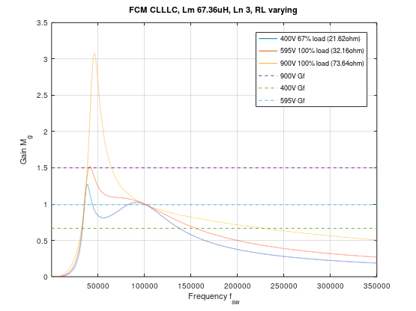
22kW tank design (HQ) Forward
At Iout=5.43A under 400V, fsw will reach around 227.5kHz. Min frequency is around 64.3kHz at 900V full load.

Slide 12
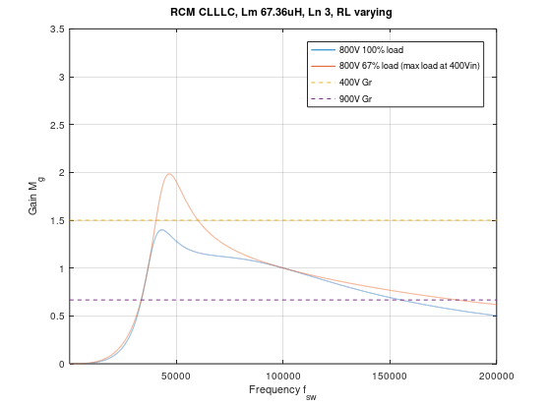
22kW tank design (HQ) Reverse
Under reverse power flow, should be able to regulate under full load/derated max load at frequency range between 60kHz to 155.2kHz.

